Slide 1
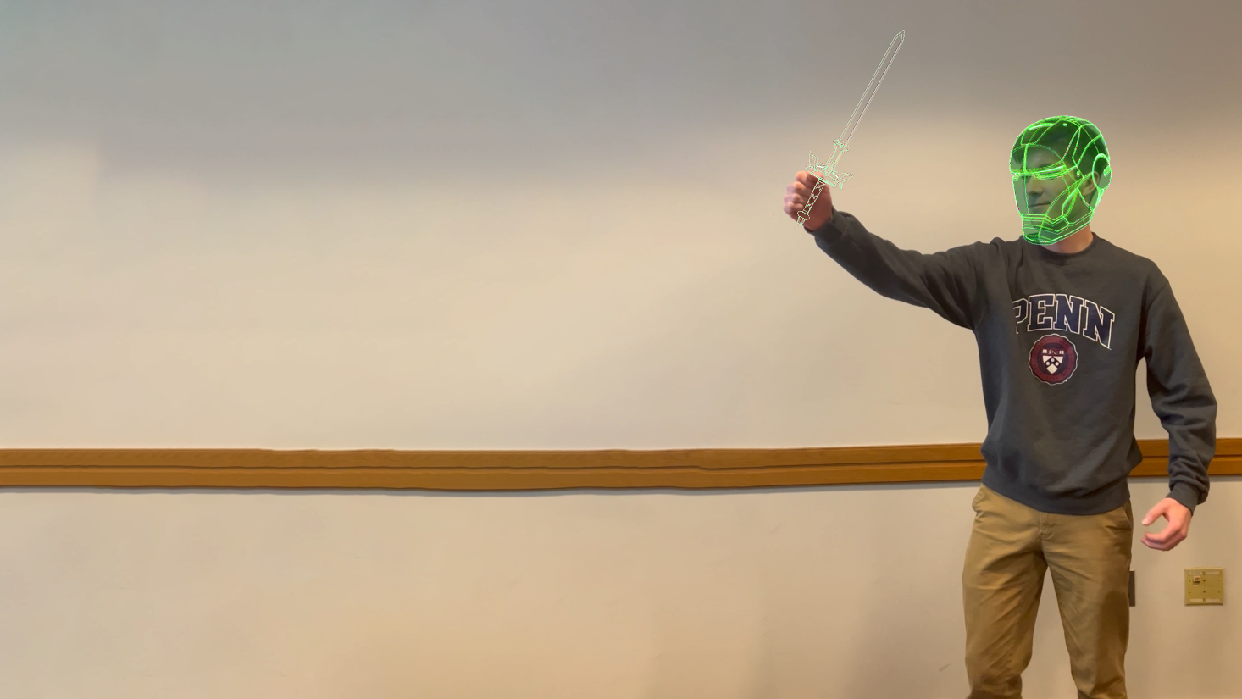
3D Scene Flow
for Mesh-Subject Correspondence Tracking
CIS-581 Final Project
PRESENTED BY:
AADIT PATEL
Ankit Billa
Daniel STEKOL
Evan GRANT
Nicholas GURNARD
RiTHWIK UDAYAGIRI

Slide 2
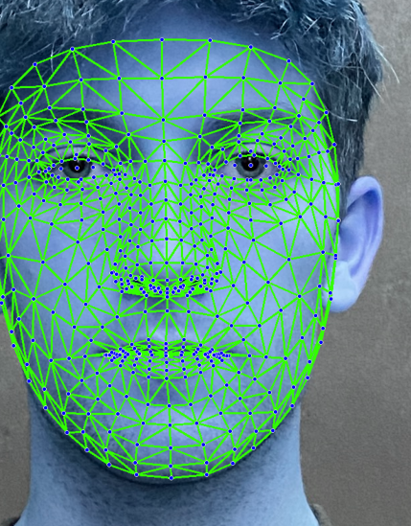
TIMELINE
Exploring and choosing from Human Pose Estimation Models
MediaPipe
Homography computation to obtain Transformation Matrices
3D mesh and ROI alignment
Superimposing 3D mesh on each frame in the correct place

Slide 3

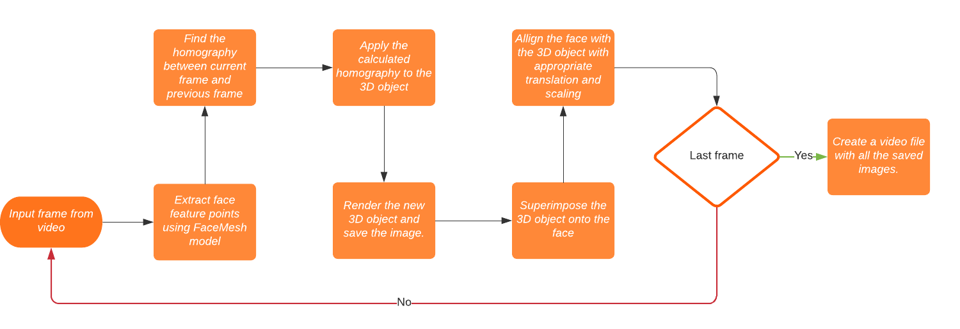
PIPELINE

Slide 4

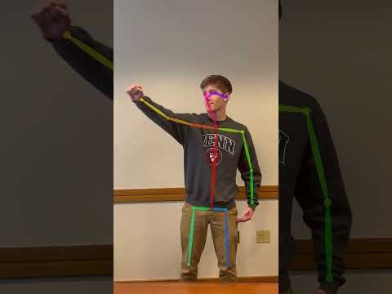
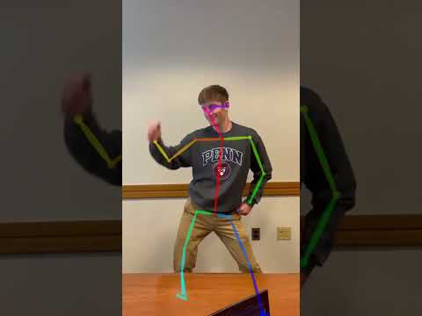
HUMAN POSE ESTIMATION
Reference: 1
openpose Approach
SLOW
FAST

Slide 5
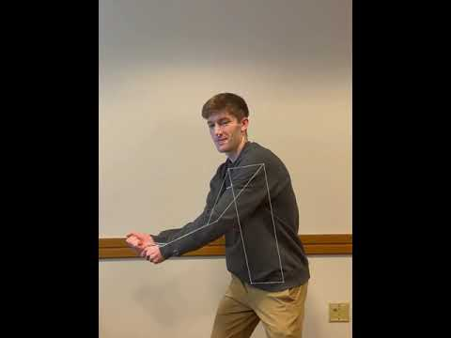
HUMAN POSE ESTIMATION
Reference: 2
MEDIAPIPE - pose estimation

Slide 6
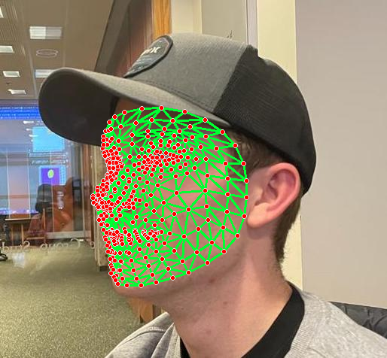
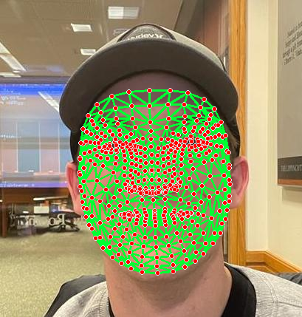
HUMAN FACE ESTIMATION
Reference: 2
MEDIAPIPE - FACEMESH MODEL

Slide 7
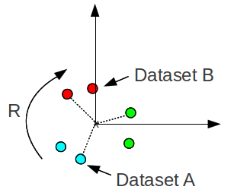
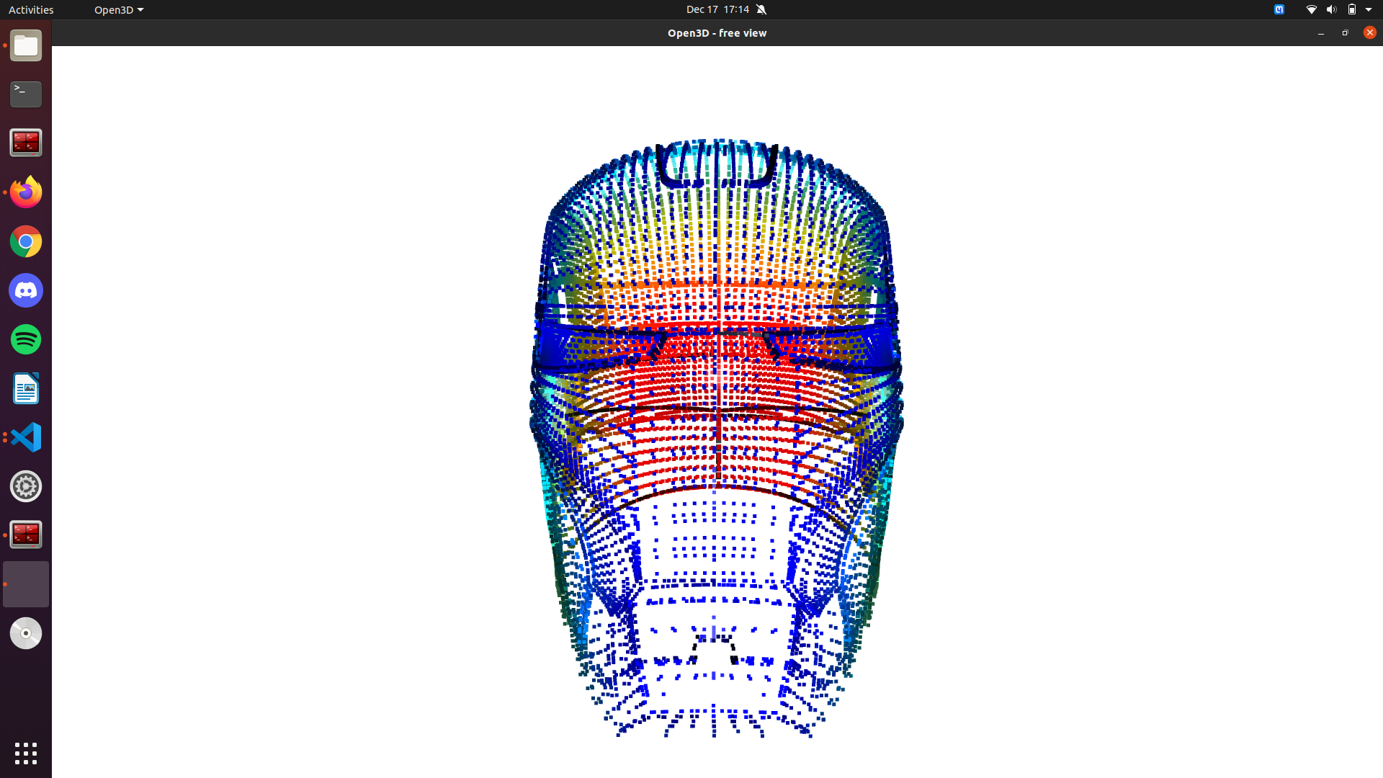
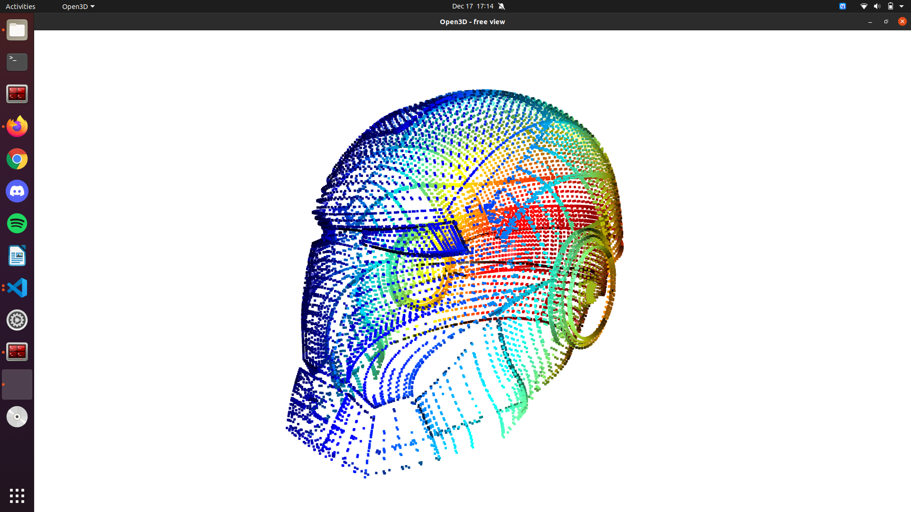
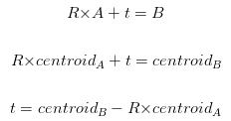
Homography estimation
Reference: 3,4,6
3d point cloud - rotation and translation
Rotation?
Translation

Slide 8
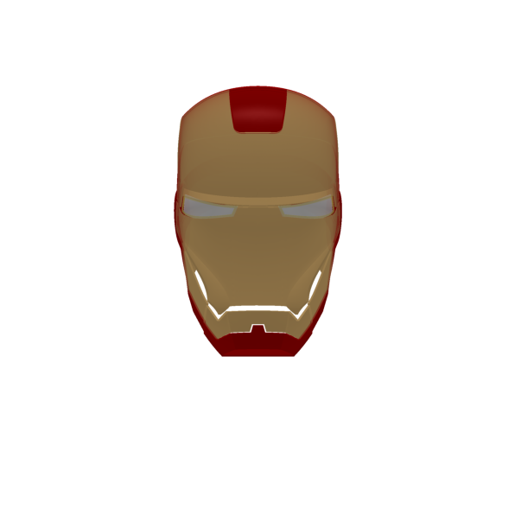
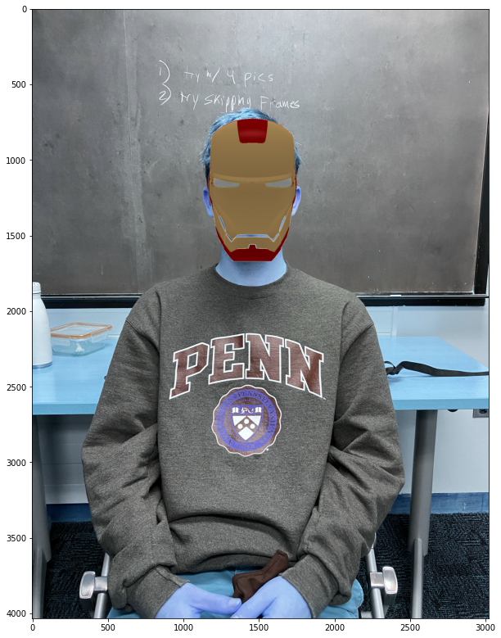
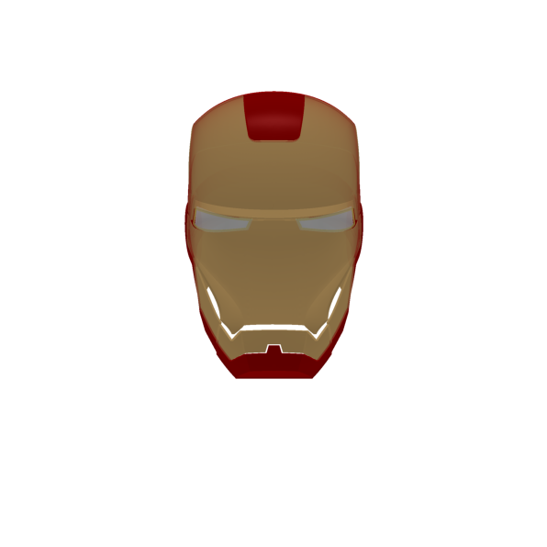
object rendering
Reference: 4,5
mesh creation and object rendering
PyTorch3D
Open3d: Select POI
Remove Background

Slide 9

VIDEO RESULTS

Slide 10

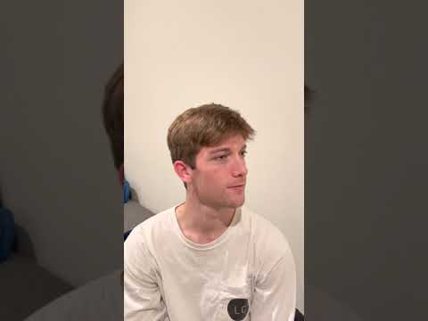
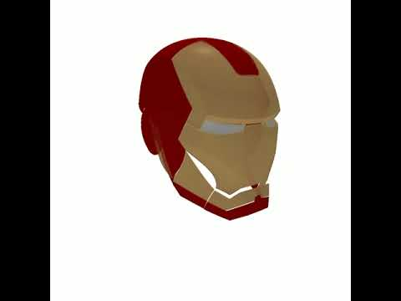
ORIGINAL VIDEO
MESH TRANSFORMATION

Slide 11
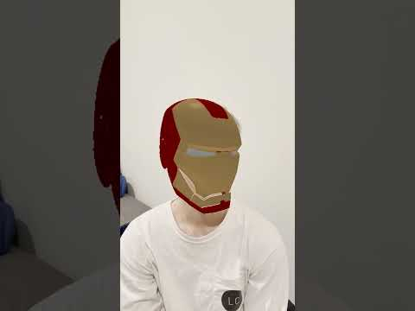
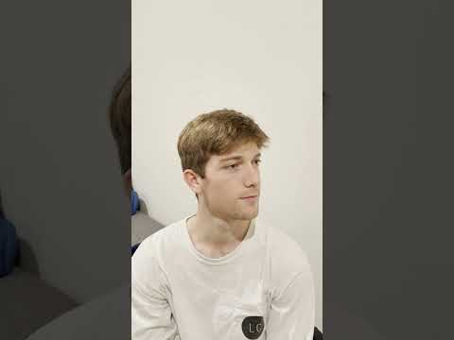
SUPERIMPOSED VIDEO

Slide 12
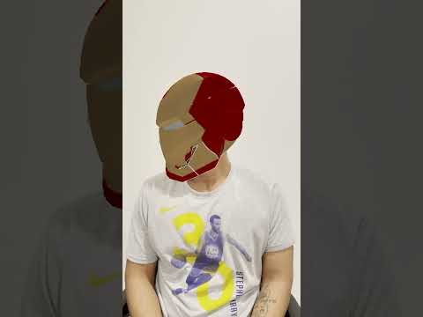
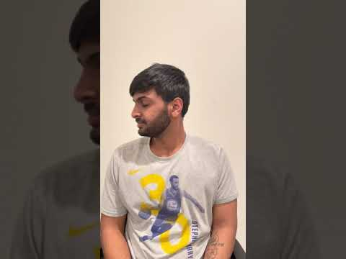
SUPERIMPOSED VIDEO

Slide 13

CHALLENGES FACED
Alignment
Translation
Scale
Axes
Depth
Libraries and dependencies

Slide 14
REFERENCES
Finding optimal rotation and translation between corresponding 3D points [6]
Least-squares fitting of two 3-D point sets [3]
PyTorch 3D [4]
OpenPose: realtime multi-person 2D pose estimation using Part Affinity Fields [1]
MediaPipe: A Framework for Building Perception Pipelines [2]
http://www.open3d.org/ [5]

Slide 15

THANK YOU

